Slide 1
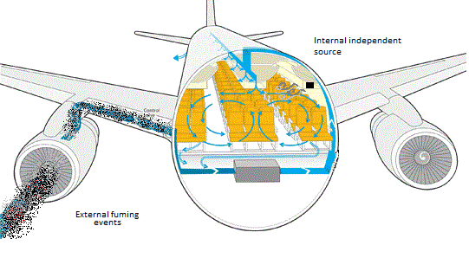
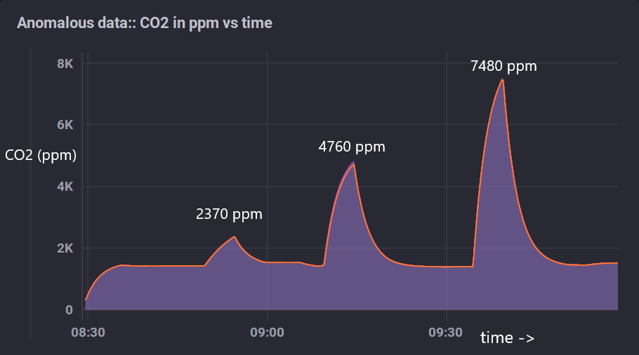
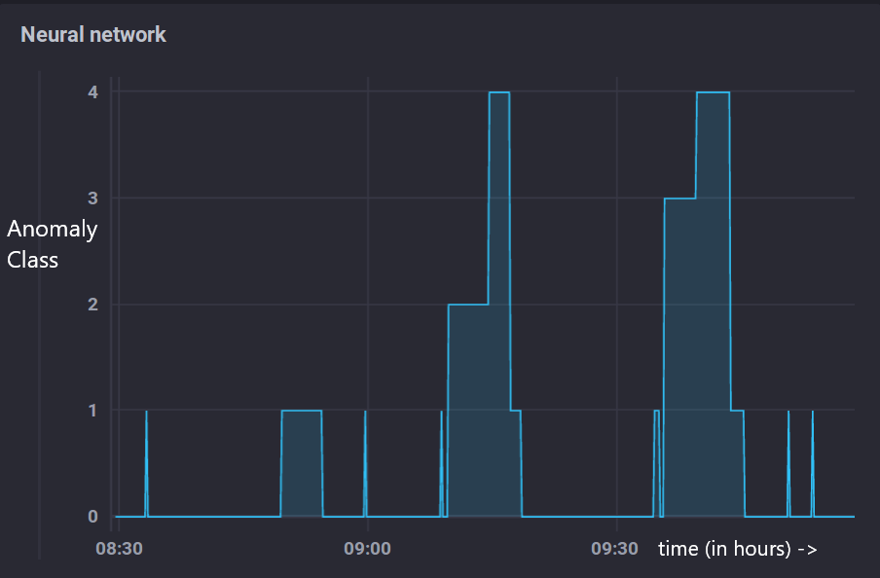
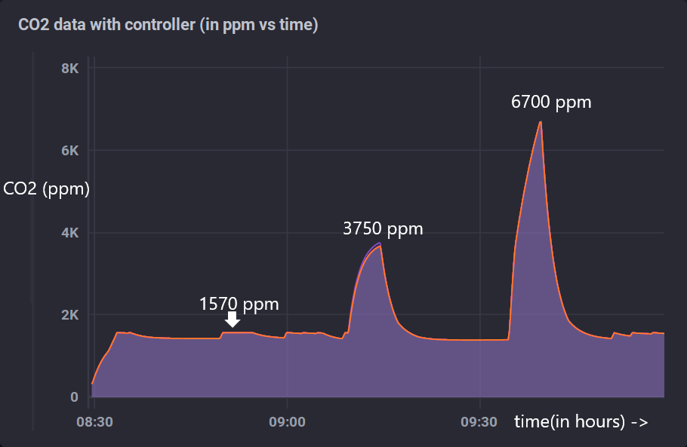
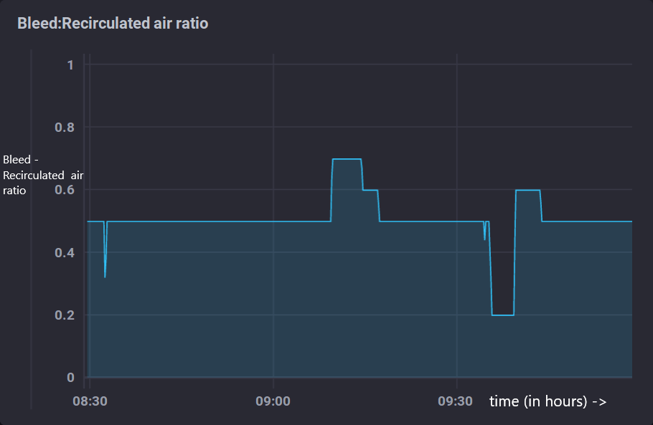


Aircraft – IoT Data management
Monitoring aircraft cabin air quality
Abstract: Real-time monitoring of cabin air quality is of paramount interest. The proposed system employs supervised ML techniques on simulated data to monitor air quality and suitably mitigate the anomaly as much as possible. The CO2 values and TPH parameters are monitored, and a neural network is trained to classify anomalies to various kinds to facilitate efficient mitigation.
Fr,X
Data generation model
GUI
Passenger Count.
Anomalous conditions
CO2 data generation model
Fr
ECS Simulink model (TPH)
Flowrate (Fr),
Bleed-
Recirculated Air ratio(X)
Humidity, Temperature, Pressure
Sensor outputs and
other parameters
Control output
Parameters
Passenger count
Set point
CO2[1:6]
Chronograf
Controller
Anomaly class
Neural network (detect root cause)
InfluxDB
1
1
1
1
No anomaly : N/A
Input Parameters
CO2 across zones (1:6)
Rate of CO2 rise(1:6)
CO2 deviation w.r.t mean CO2 level in the cabin (1:6)
Temperature
Pressure
Humidity
Passenger Count
2
2
2
2
1
0
Ventilation Efficiency: Increase Flowrate, Do not alter bleed-recirculation ratio (0.5).
3
3
3
3
2
1
Internal Independent source: Maintain Flowrate, Increase bleed-recirculation ratio to 0.7
4
4
4
4
3
2
20
18
18
18
13
3
External event: Maintain Flowrate, Increase bleed-recirculation ratio to 0.2
21
17
17
17
14
4
Normal Conditions being restored : Maintain Flowrate, Increase bleed-recirculation ratio to 0.6
CO2 particles getting mixed with cabin air
22
19
19
19
15
20
20
20
Multi-layered perceptron for anomaly
detection and classification
Scale,
X-axis:
1 unit = 30 min
Y-axis:
1unit = 2000 ppm
Co2 Concentration in ppm
Time (hh:mm)
Aerospace Network Research Consortium

